Slide 1
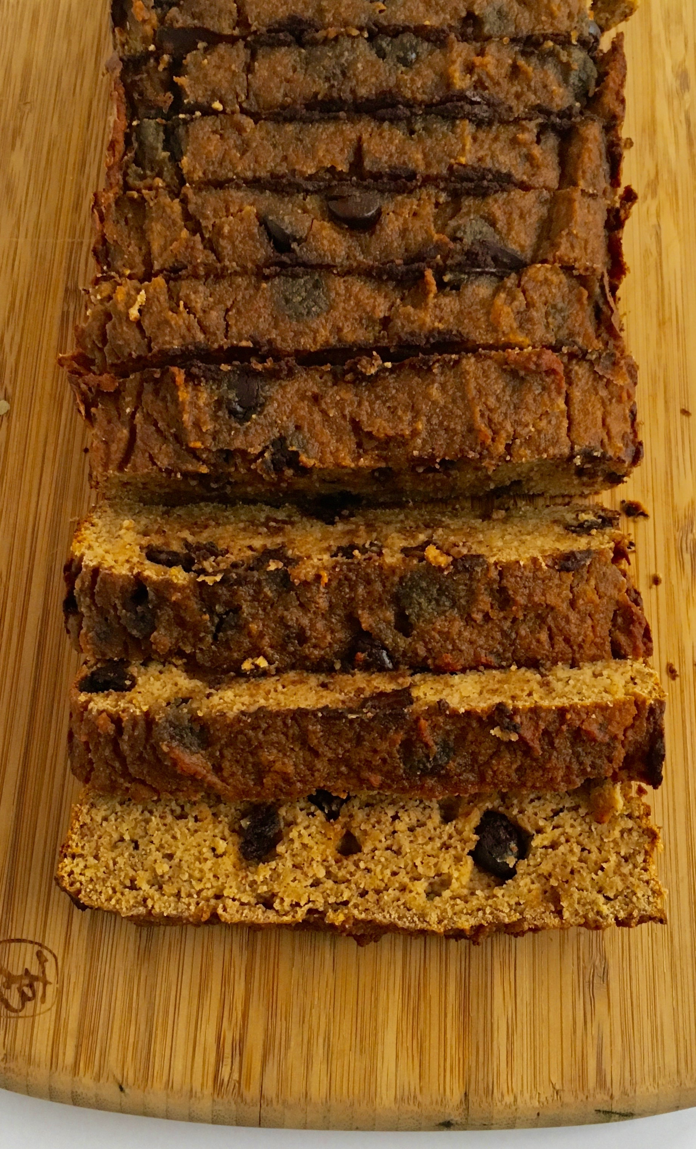
Banana Chocolate Chip Bread
(Ambitious Kitchen)
INGREDIENTS:
3 medium ripe bananas, mashed (about 1 1/4 cups mashed banana)
1 teaspoon vanilla extract
1/4 cup almond butter (unsweetened)
2 eggs, at room temperature
1/2 cup coconut flour
1/2 teaspoon baking soda
1/2 teaspoon baking powder
1/2 teaspoon cinnamon
1/4 teaspoon salt
1/2 cup dark chocolate chips
INSTRUCTIONS:
Preheat oven to 350 degrees F. Line a 8x4 inch or 9x5 inch loaf pan with parchment paper and spray with nonstick cooking spray.
In the bowl of an electric mixer, combine bananas, vanilla and almond butter; mix until well combined, smooth and creamy. Add in eggs, one at a time and mix on medium speed until combined. With the mixer on medium-low speed, add in coconut flour, baking soda, baking powder, cinnamon and salt; mix again until just combined. Gently fold in chocolate chips.
Pour batter into prepared pan and smooth top. Bake for 30-40 minutes or until tester inserted into center comes out clean. Remove from oven and place on wire rack to cool for 20 minutes, then carefully invert, remove bread from pan and place back on wire rack to cool completely. Cut into 12 slices.
NOTES:
For best results, use bananas with lots of brown spots.
Feel free to use peanut butter instead of almond butter (although then it would not be paleo).
To make Paleo friendly omit chocolate chips.

