Slide 1
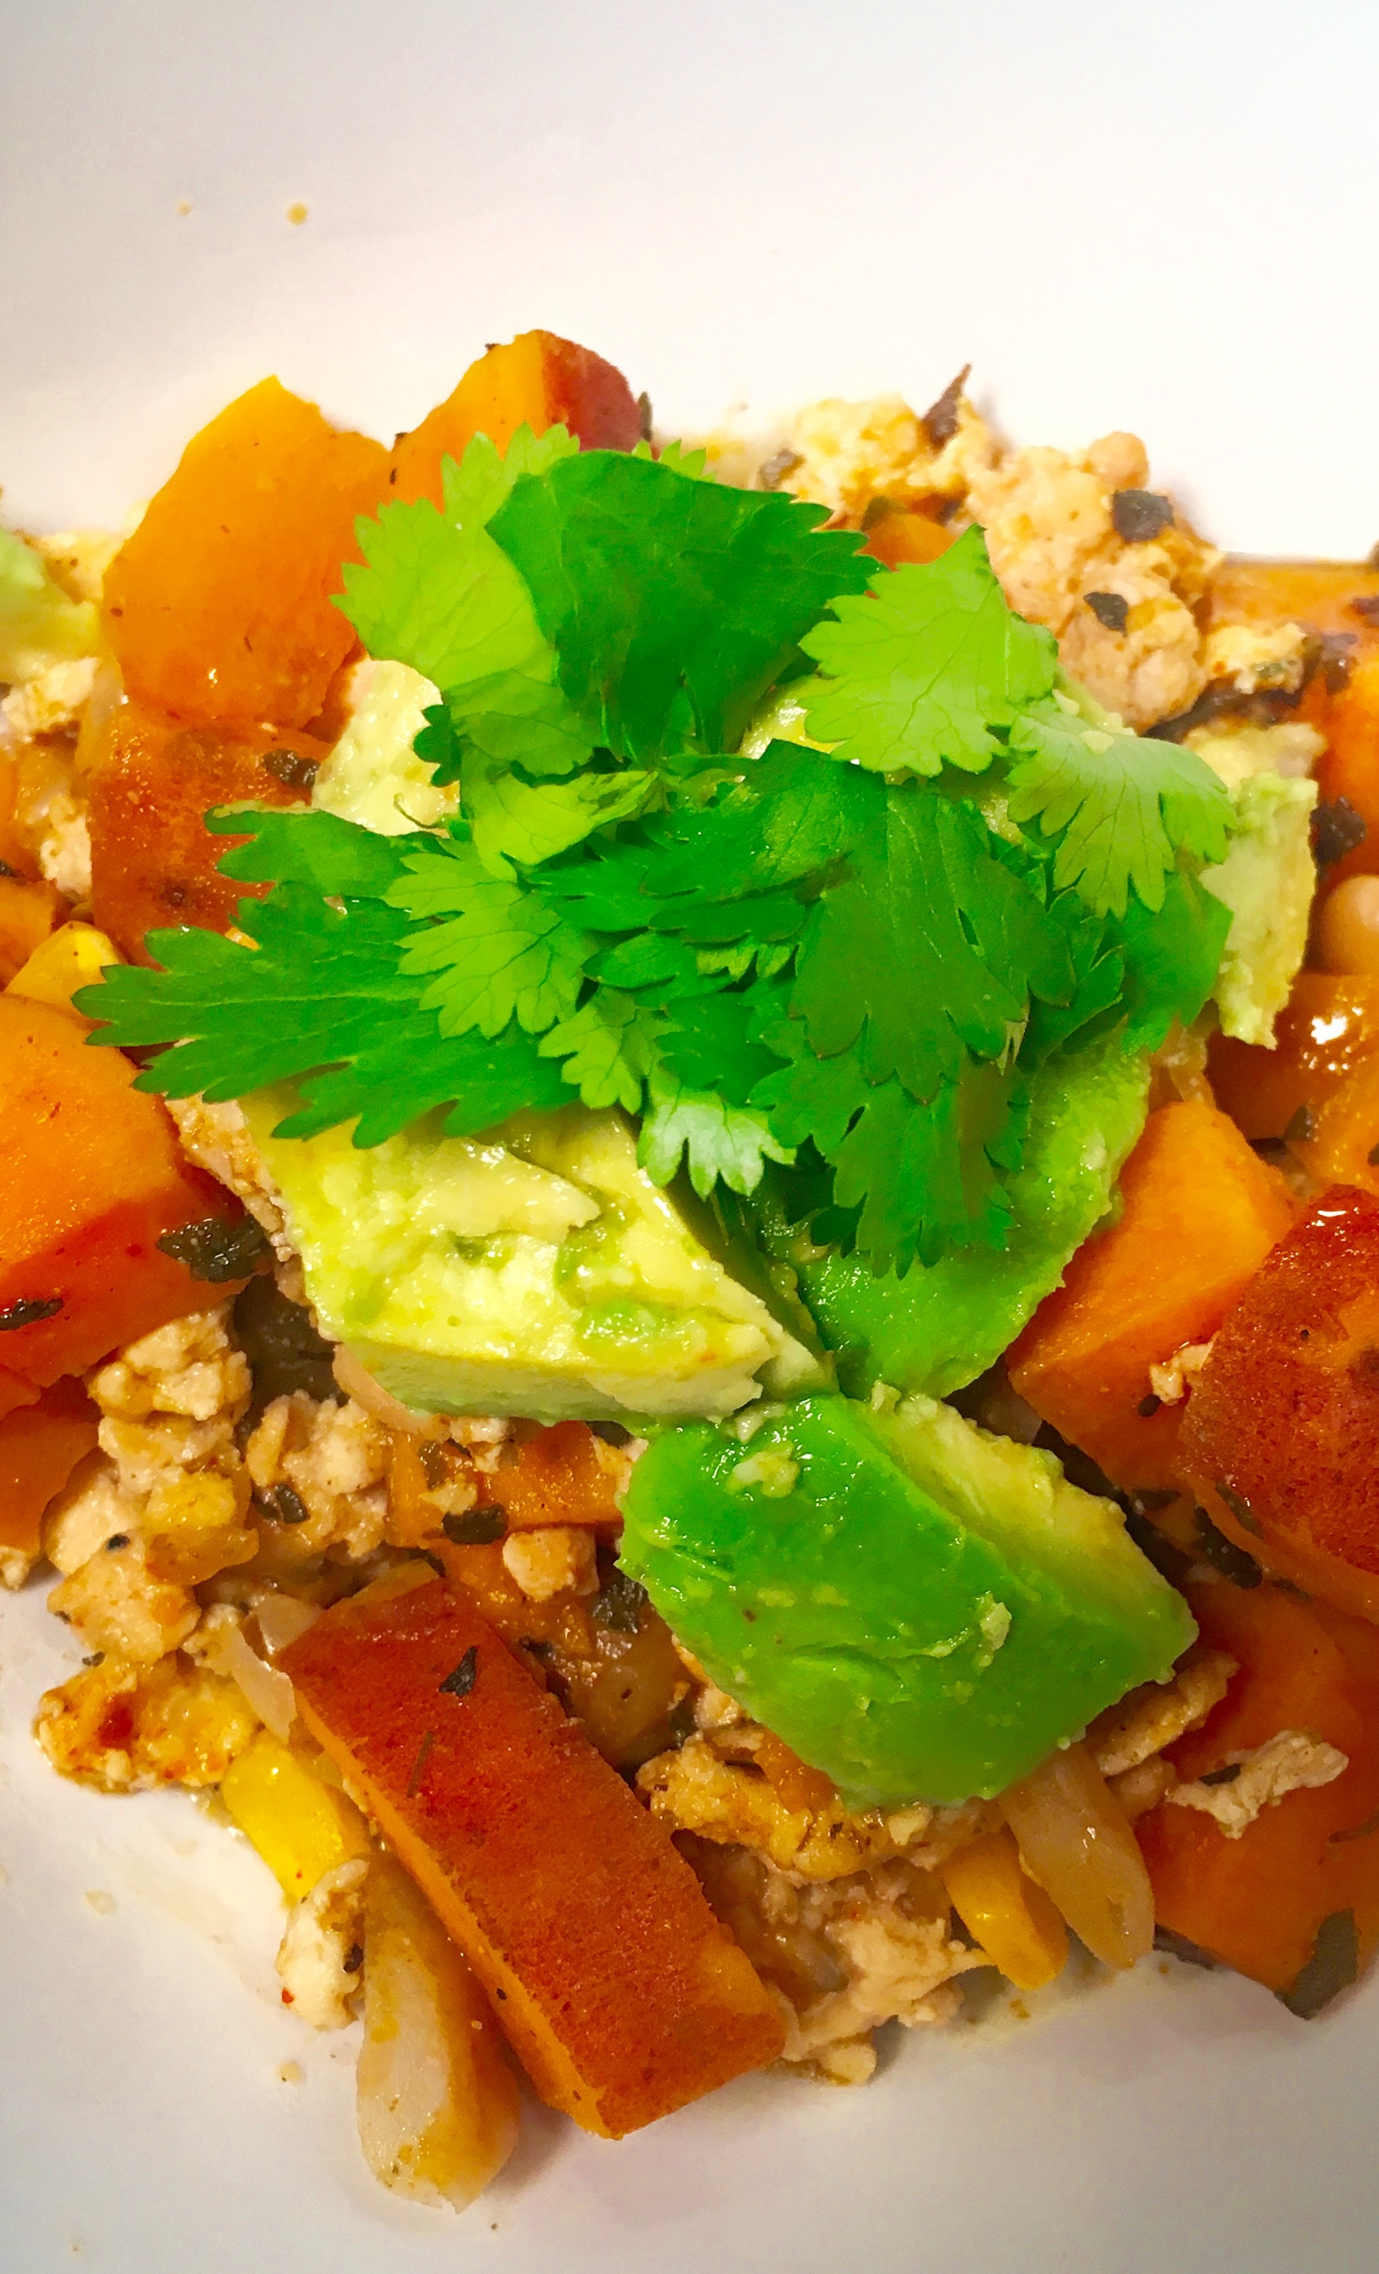
Chicken Chili with Sweet Potatoes (Inspired by David Bonom from Eating Well)
Ingredients:
2 tablespoons extra-virgin olive oil or coconut oil
1 large onion, chopped
3 cloves garlic, minced
2 cups cubed sweet potato (1/2-inch)
1 medium bell pepper (any color), chopped
2 tablespoons chili powder
2 teaspoons ground cumin
1 teaspoon dried oregano
1 15-ounce can low-sodium cannellini beans, rinsed
2 cups low-sodium chicken broth or homemade chicken stock
1 cup frozen corn, thawed
1-1 ¼ lb ground chicken
1 teaspoon salt
1/2 teaspoon ground pepper
Salt & pepper to taste
Avocado and cilantro for garnish
Instructions
Heat large pot (Dutch over works great) over medium-high heat. Pour small amount of oil into pan. Once pan is hot add the ground chicken, salt and pepper stirring frequently to break up the clumps, approximately 5 minutes or until cooked with no hint of pink. Remove from pan and set aside.
Add remaining oil along with onion and garlic, sweet potatoes and bell pepper; cook, stirring occasionally, until the vegetables are slightly softened, 5 to 6 minutes. Stir in chili powder, cumin and oregano and cook, stirring, until fragrant, 1 minute.
Add beans and broth (or stock) and bring to a boil. Reduce heat, partially cover and simmer gently for 15 minutes.
Increase heat to medium-high and stir in corn; cook 1 minute. Add back chicken and cook until heated through, 1 to 2 minutes more. Remove from heat. Stir in salt and pepper.
Serve topped with avocado and/or cilantro, if desired.
Notes:
I use organic corn, chicken and chicken broth. Serve with clean tortillas chips, if desired.

